Slide 1

Server and Systems Administration Module Code : CSC3504
Simeon NDAYAMBAJE
Server and Systems Administration , CSC3504
1

Slide 2
Chapter 3
Server Roles and Services

Slide 3
Contents
Lightweight Directory Access Protocol (LDAP)
Domain name system (DNS) server
Dynamic Host Configuration Protocol (DHCP)
Server Manager
Application Server
Hyper-V
File Transfer Protocol( FTP)
Server Backup
Directory
Web Server
Network policy
Print Services
Terminal Services

Slide 4

Directory
Active Directory
Enables the server to be configured as a domain controller to centrally manage, authenticate, and authorize users, groups, and computers on the network.

Slide 5
Directory
Directory service
refers to the collection of software, hardware, and processes that store information about an enterprise and make that information available to users.
A directory service is a centralized database that stores and organizes information about users, devices, resources, and other objects in a network.
An example of a directory service is a domain name system (DNS) server.

Slide 6
Characteristics of Good directory services
With directory A system should meet the following criteria:
information store can be distributed among many different physical locations and appears as a single database.
The information store can accommodate new types of objects, as necessary, to meet the network’s changing needs.
Users and administrators can easily search for information from various locations throughout the network.
The system has no dependency upon physical location.
The information store is accessible from many different operating systems.

Slide 7
Characteristics of Good directory services
A system should meet the following criteria:
Hierarchical naming model: Uses the concept of containment to reduce ambiguity between names and simplify administration.
Extended search capability: allowing searches on individual attributes of entries.
Distributed information model: A directory service enables directory data to be distributed across multiple servers within a network.

Slide 8
Characteristics of Good directory services
A system should meet the following criteria:
4. Shared network access: While databases are defined in terms of APIs, directories are defined in terms of protocols.
5. Replicated data: Directories support replication (copies of directory data on more than one server) which make information systems more accessible and more resistant to failure.

Slide 9
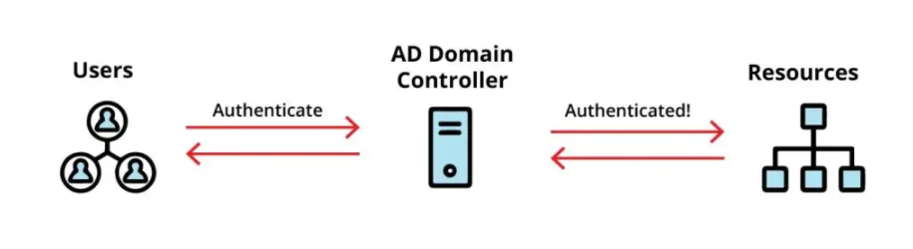
Enterprise-Wide Directory Services
Directory Server provides two ways in which applications can access its enterprise-wide directory:
Lightweight Directory Access Protocol (LDAP)
Directory Services Markup Language (DSML)

Slide 10
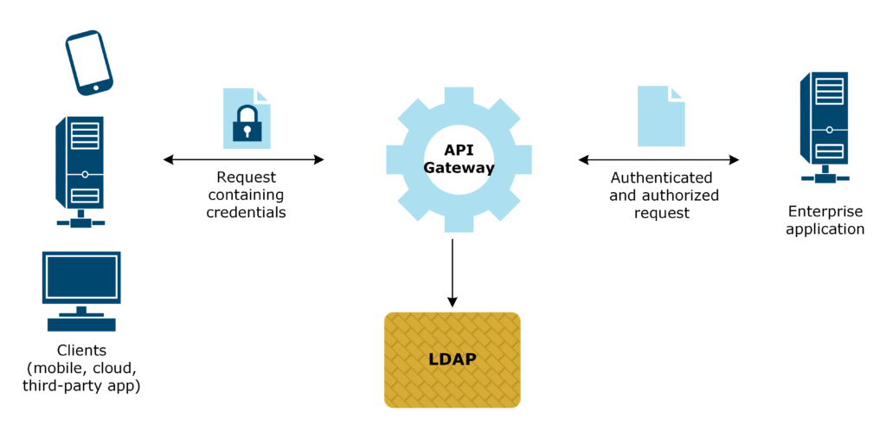
Lightweight Directory Access Protocol (LDAP)
LDAP allow client applications and servers use to communicate with one another.
LDAP is a widely used open standard protocol used for accessing and managing directory services over a network.

Slide 11
LDAP Operations
LDAP defines several operations for interacting with directory services, including:
Bind: Establishes a connection between the client and server, typically with authentication.
Search: Retrieves information from the directory based on specified criteria.
Creating(add), delete, and update directory entries.
Compare: Compares an attribute value of an entry with a specified value.
Unbind: Terminates the connection between the client and server.

Slide 12
LDAP Structure
Client-Server Architecture:
LDAP clients send requests to LDAP servers, LDAP servers process those requests and return the results.
The server typically hosts the directory database and responds to queries from clients.
Hierarchical Structure:
LDAP directories typically organize information in a hierarchical structure similar to a tree.
Each entry in the directory represents an object, such as a user or a device, and is uniquely identified by a distinguished name (DN).
Entries can contain attributes, which are pieces of information associated with the object.

Slide 13
LDAP Security and Standard
Security: LDAP supports various authentication mechanisms, including simple authentication with username and password, as well as more secure methods like Transport Layer Security (TLS) for encrypted communication.
Standardization: LDAP is standardized by the Internet Engineering Task Force (IETF) to ensuring interoperability between different implementations.

Slide 14
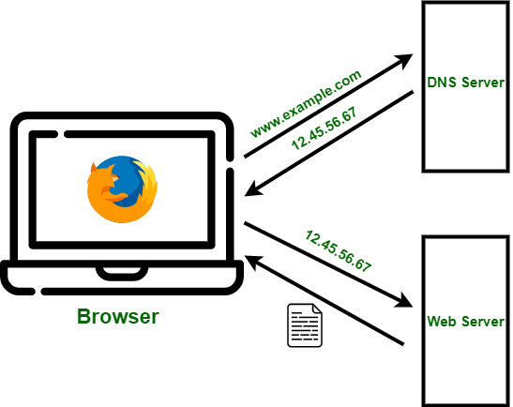
Domain name system (DNS) server
The Domain Name System (DNS) is a distributed directory that resolves human-readable hostnames, such as www.uok.ac.rw, into machine-readable IP addresses like 50.16.85.103.

Slide 15
How does DNS work?
The process of DNS resolution involves converting a hostname (such as www.example.com) into a computer-friendly IP address (such as 192.168.1.1).
DNS is like a phone book for the internet. If you know a person’s name but don’t know their telephone number, you can search it from phone book.

Slide 16
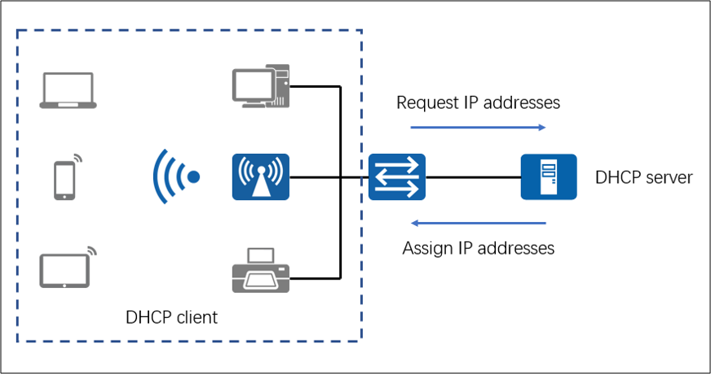
DHCP (Dynamic Host Configuration Protocol)
DHCP is a network management protocol used to dynamically assign an IP address to any device, or node, on a network so it can communicate using IP.

Slide 17
Dynamic Host Configuration Protocol (DHCP)
DHCP (Dynamic Host Configuration Protocol) is a protocol used to provide quick, automatic, and central management for the distribution of IP addresses within a network.
DHCP port number are : server is 67 & client is 68
DHCP is also used to configure the proper subnet mask, default gateway, and DNS server information on the
Components of DHCP
A protocol that delivers host-specific configuration parameters from a DHCP server to a host.
A mechanism for the allocation of network addresses to hosts.

Slide 18
Three Mechanisms supported by DHCP for IP address allocation?
Automatic allocation: DHCP assigns a permanent IP address to the host.
Dynamic allocation: DHCP assigns an IP address for a limited period of time. Such a network address is called a lease.
Manual allocation: The host's address is assigned by a network administrator.

Slide 19
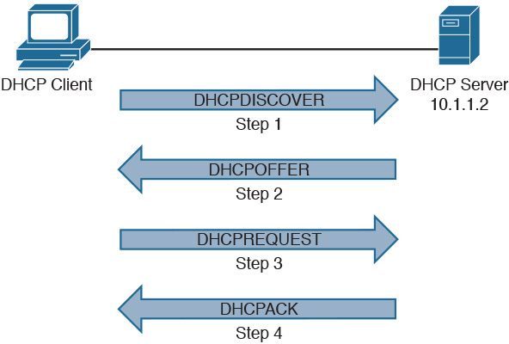
DHCP Process

Slide 20
DHCP Discover message (step 1)–
This is a first message generated in the communication process between server and client.
This message is generated (broadcasted)by Client host in order to discover if there is any DHCP server/servers are present in a network or not.
This message is broadcasted to all devices present in a network to find the DHCP server.

Slide 21
DHCP offer message (step 2)–
The server will respond to host
This message is broadcasted by server.
If there are more than one DHCP servers present in the network then client host will accept the first DHCP OFFER message it receives.
Also a server ID is specified in the packet in order to identify the server.

Slide 22
DHCP request message (step 3)–
When a client receives a offer message, it responds by broadcasting a DHCP request message.
Sent by clients to request or confirm the offer of an IP address from a specific server and to confirm an existing lease.
.A Client ID is also added in this message.

Slide 23
DHCP acknowledgement message (step 4)–
In response to the request message received, the server will make an entry with specified client ID and bind the IP address offered with lease time.
Now, the client will have the IP address provided by server.

Slide 24
Advantages of DHCP
The advantages of using DHCP include:
Centralized management of IP addresses
Ease of adding new clients to a network
Reuse of IP addresses reducing the total number of IP addresses that are required
Simple reconfiguration of the IP address space on the DHCP server without needing to reconfigure each client

Slide 25
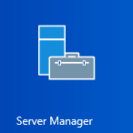
Server Manager
Server Manager is a management console (MMC) in Windows Server 2012,2016……
Server Manager allows you to add server roles / features, manage and deploy server remotely.

Slide 26
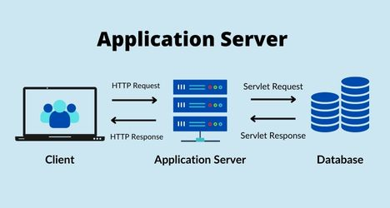
Application Server
Application Server Supports hosting and managing high-performance distributed business applications through the .NET Framework, web services, and application communications services.

Slide 27
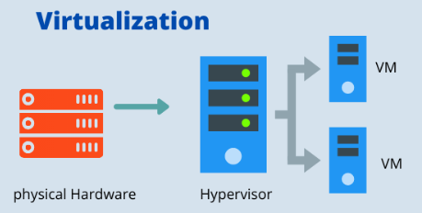
Hyper-V
Supports hosting and managing virtual machines, including both Windows and non-Windows guests.

Slide 28
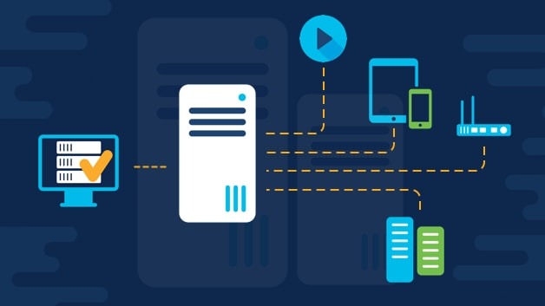
Network Policy
Network policy is a collection of rules that govern the behaviors of network devices.
Eg: Just as a federal or central government may lay down policies for state or districts to follow to achieve national objectives, network administrators define policies for network devices to follow to achieve business objectives.
Notes:
The Network Policy and Access Services role supports in Remote Authentication , routing, and remote access through VPNs.
Eg: Just as a federal or central government may lay down policies for state or districts to follow to achieve national objectives, network administrators define policies for network devices to follow to achieve business objectives.

Slide 29
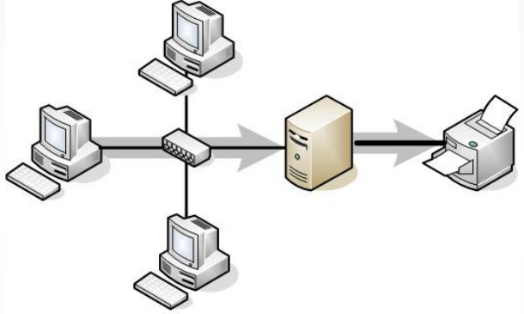
Print Services
The Print Services role supports printer sharing and printers management.

Slide 30
Terminal Services
The Terminal Services role supports access to remote desktop services, remote applications, and may function as a gateway to remote clients.

Slide 31
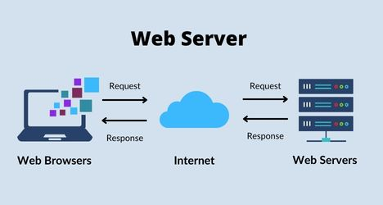
Web Server
The Web Server role allows the server to host HTTP, HTTPS, and FTP sites.

Slide 32
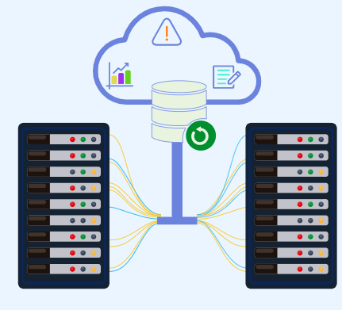
Windows Server Backup
Installs a Microsoft Management Console to support backup and recovery of Windows servers.

Slide 33
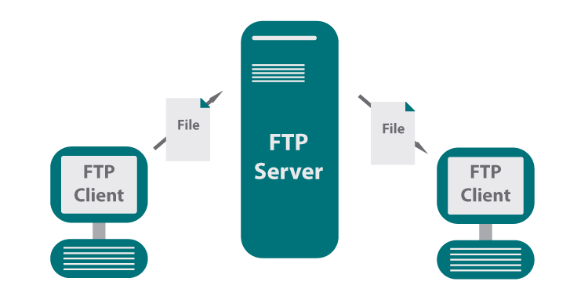
File Transfer Protocol( FTP)
FTP is a network protocol used to transfer data from one computer to another through a network.
The most common use for FTP is to download files from the Internet to a local computer, or upload files from a local computer to a remote server.

Slide 34
Thank you

